Slide 1
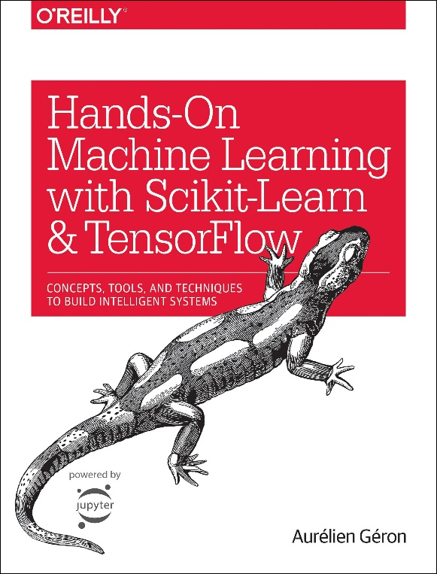
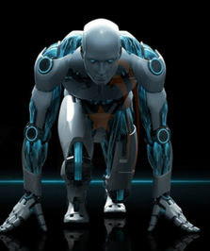
Novice Machine Learning E2E Project
Part 11
Linear Regression model - Trial
Mukunthan Ragavan

Slide 2
E2E Machine Learning Project
Look at the Big picture.
Get the Data (Split the Data, Stratifying the Data).
Discover and visualize the data to get insights.
(Scatter with plot with density and color map, Correlation)
Prepare the data for ML algorithms. (Data Cleaning, One Hot Encoding, Custom Transformers, Pipelines)
Select a model to train it. (Linear Regression model)
Fine-tune your model.
Present your solution.
Launch, monitor and maintain your system.

Slide 3
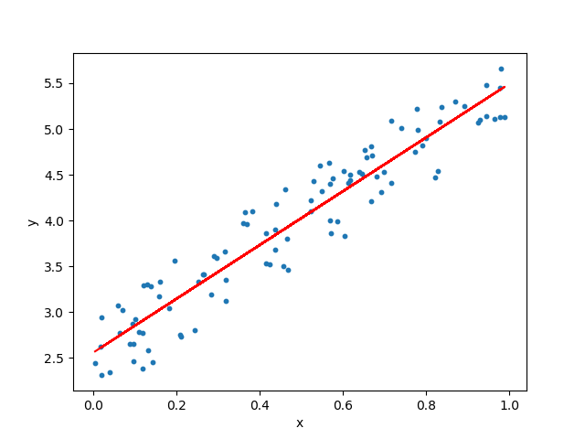
Linear Regression Model: Dependent variable is continuous, independent variable(s) can be continuous or discrete, and nature of regression line is linear. Linear Regression establishes a relationship between dependent variable (Y) and one or more independent variables (X) using a best fit straight line (also known as regression line).

Slide 4
Coding in action !

Slide 5
Thanks All for watching and your subscription !

